Slide 1
Instructions for Grade 12 Students
How Do I Sign Up for myPass?

Slide 2
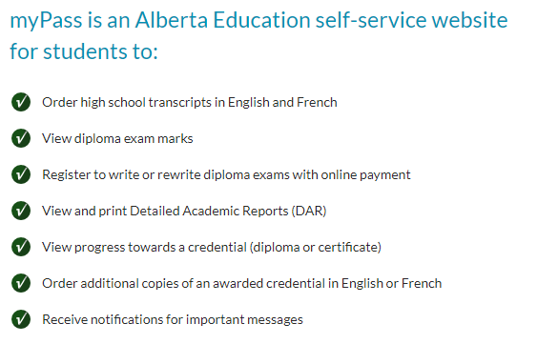
Be sure to check your January Diploma exam registrations in your account too.
Notes:
When conducting research, it is easy to go to one source: Wikipedia. However, you need to include a variety of sources in your research. Consider the following sources:
Who can I interview to get more information on the topic?
Is the topic current and will it be relevant to my audience?
What articles, blogs, and magazines may have something related to my topic?
Is there a YouTube video on the topic? If so, what is it about?
What images can I find related to the topic?

Slide 3
Setting Up Your Account
1
The office sets up your personal email address in PASI.
This should have been given to your advisor last week.
If you did not provide your advisor with your personal email address, please see Christina in the main office.
2
Ask your advisor for your Alberta Student Number (ASN) if you do not already know it. You will need this when you set up your account.

Slide 4
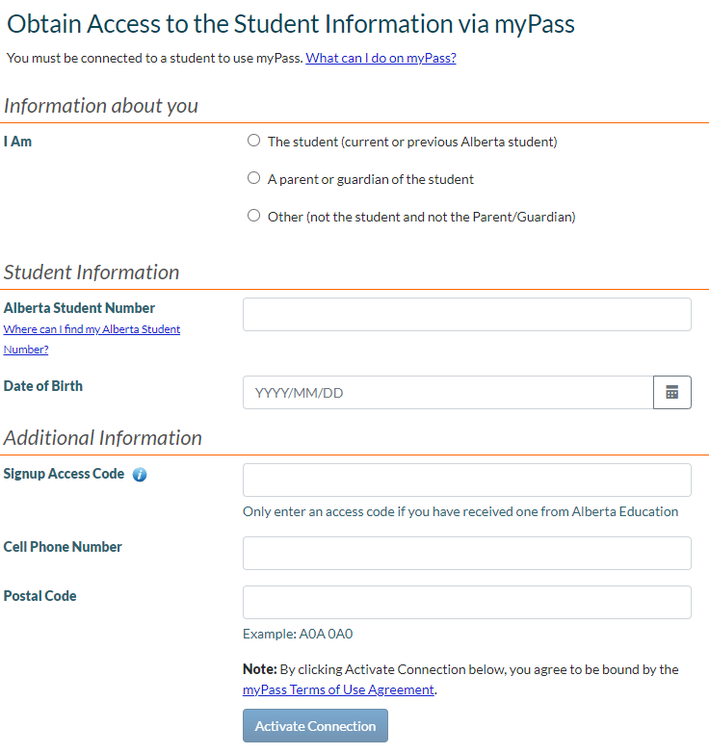
Slide 3
3
Visit myPass to set up your account
You will not need this code if you gave the office or your adviser your personal email address.

Slide 5
How to Use myPass
Notes:
Once you find your sources, you will want to evaluate your sources using the following questions:
Author:
Who is the author?
Why should I believe what he or she has to say on the topic?
Is the author seen as an expert on the topic? How do you know?
Current:
How current is the information in the source?
When was the source published?
Is the information out-of-date?
Accuracy:
Is the content accurate?
Is the information presented objectively? Do they share the pros and cons?

Slide 6
If you are unable to create your account at school or would like more information
click here.
Notes:
You can use this slide as your opening or closing slide. Should you choose to use it as a closing, make sure you review the main points of your presentation. One creative way to do that is by adding animations to the various graphics on a slide. This slide has 4 different graphics, and, when you view the slideshow, you will see that you can click to reveal the next graphic. Similarly, as you review the main topics in your presentation, you may want each point to show up when you are addressing that topic.
Add animation to images and graphics:
Select your image or graphic.
Click on the Animations tab.
Choose from the options. The animation for this slide is “Split”. The drop-down menu in the Animation section gives even more animations you can use.
If you have multiple graphics or images, you will see a number appear next to it that notes the order of the animations.
Note: You will want to choose the animations carefully. You do not want to make your audience dizzy from your presentation.

