Slide 1
Powerschool Course Selection
Through the Student Portal

Slide 2
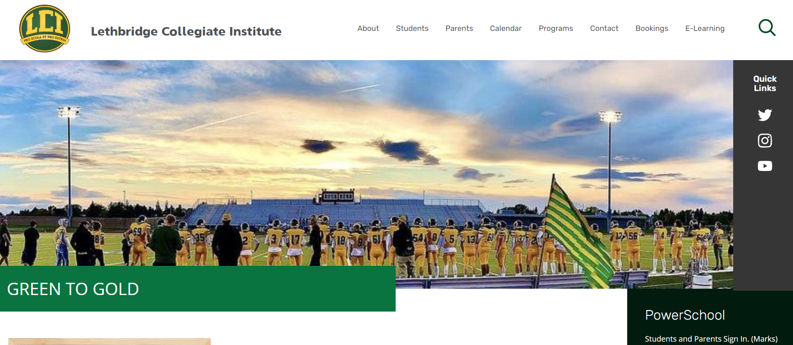
Log on to Powerschool
Go to LCI Website
Click on the Power School Link
Log on using your ID and password
If you do not know your ID and password, get it from the office

Slide 3
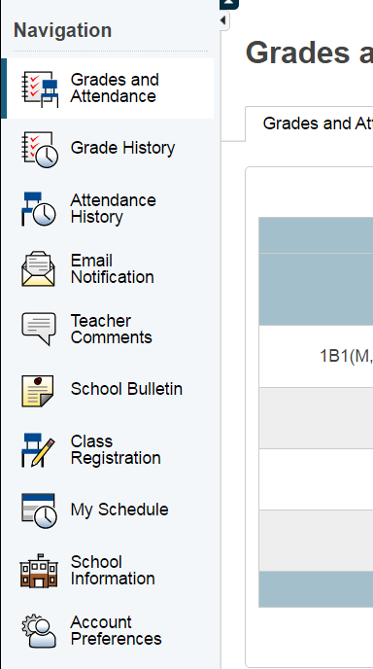
Go to Course Selection screen
Select ‘Class Registration’ from menu bar on left

Slide 4
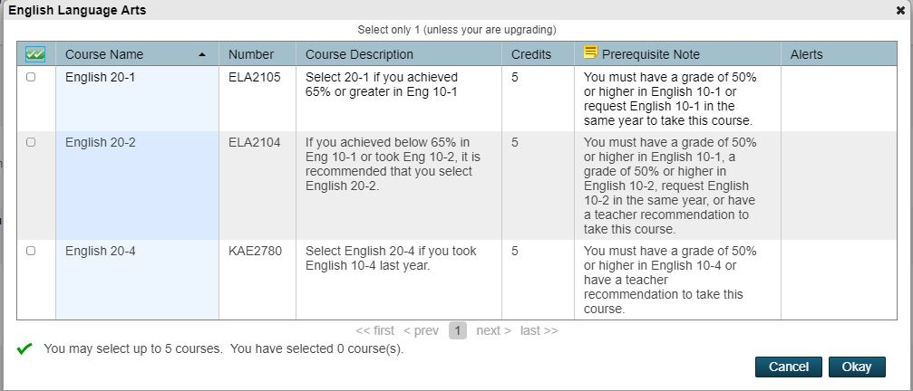
Things to Note Before Beginning
Click pencil icon to select courses in that group:
Some course groups have more than 1 page so scroll to the bottom:
Look for prerequisite info in last 2 columns of the selection page. If you have not met the pre-requisite you will not be able to select the course and/or complete your registration.
To select course use check box on left

Slide 5
3 Prerequisite types
First type: you must have passed the previous course with 50%. E.g. to take English 20-2, you must have passed (50%) English 10-2 or English 10-1
Second Type: Teacher Recommendation. You must see your advisor or subject area teacher to put a recommendation in Powerschool before you go on and register.
Third Type: Concurrent Registration. You must select the pre-requisite course at the same type you select the course you want (e.g. Physics 20 and Physics 30) if you have not passed it
Note: If you are currently taking a course, the system assumes you have passed it. At the end of the semester we will take a look to make sure this happens. If you do not pass a pre-requisite course this semester, your schedule will be changed!

Slide 6
Final Step: Submit
When you have made all your selections, scroll to the bottom and use submit button:
If you get a ‘Request Submission Failed’ notice, you will have to go back and fix the problem it indicates before you are done.
As long as the system is open you can go back and change requests. After that you will be able to view them

