Slide 1
High School E-Learning Opportunities
Applications are Due via the Lethbridge School Division Website by May 17th 2021

Slide 2
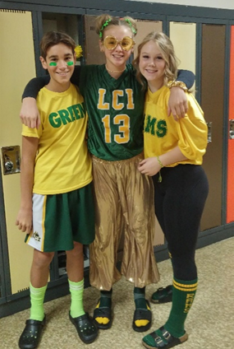
Our Vision for E-Learning
Students will have a path to graduation that allows them to take a full compliment of courses on-line
Students will be part of a scheduled class with synchronous instruction and daily lessons/interactions with their teachers
Students can supplement their online learning needs with on-campus classes or extracurricular activities if they so desire
Allow for flexibility regarding class scheduling to allow for open afternoons to participate in on-campus courses, gain credits through work experience, and pursue athletic endeavors

Slide 3
Synchronous vs A-Synchronous
Synchronous Instruction
This type of instruction is what you would normally envision for regular classroom lessons. Lessons are delivered to the entire classes by a qualified teacher. Students progress through a course together with opportunities to ask questions and get help in a timely manner.
vs
A-Synchronous Instruction
This type of instruction is more common with “distance education”.
Students are given learning packages or modules to work through on their own. The learning is primarily self-facilitated with occasional help from an instructor that is primarily there
to mark or grade assessments

Slide 4
Advantages to
Synchronous Learning
The best part of High School education is what teachers provide in the classroom
High School curriculum can be very challenging so having professional teachers deliver lessons gives students the best chance at academic success
Classroom discussion, Q & A, teachable moments, and opportunities to convers with their peers is what gives students the full education experience
Students can ask questions and get help in real time without having to book an appointment with their teachers
Students belong to a classroom community where they are encouraged to engage with peers regularly, rather than learn as an island unto themselves
Students are part of a school community where they belong and can graduate from!

Slide 5
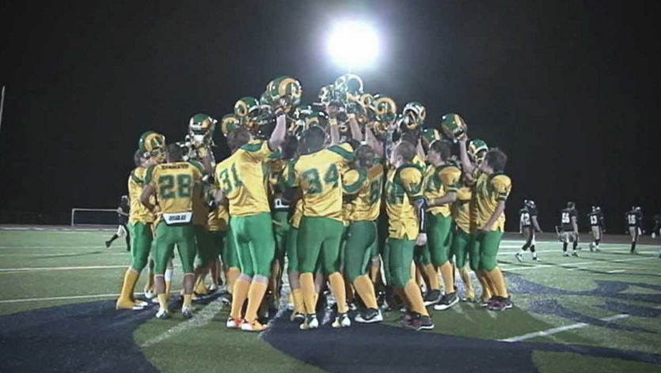
Why Would I Come on Campus?
At LCI, we still believe in giving our students the best high school experience possible, even in an E-Learning environment. This includes learning opportunities that happen outside of the conventional classroom like participating in school athletics, being part of fine arts performances, or partaking in extracurricular clubs. LCI students registered as E-Learners are still LCI students and will be invited to be part of all the amazing opportunities we provide outside of the classroom.

Slide 6
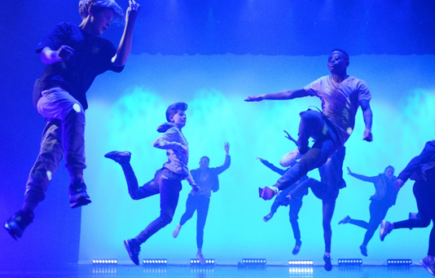
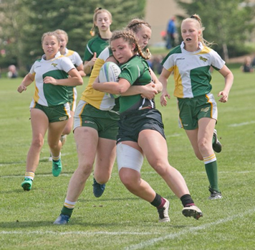
Other Opportunities for E-Learners
Second-to-none learning opportunities in the trades including mechanics, carpentry, autobody, and welding. Not to mention a full dance studio, drama theater, and band/choir studios
Be part of the provincial champion LCI Rams football legacy
Annual LCI Dance Academy production at the Yates theater
LCI Rugby is one of dozens of athletic opportunities
Award winning LCI chamber choir
LCI Clippers Curling team

Slide 7
Can I be a 100% Online Learner?
The answer to that question is YES!
LCI also hosts an “Independent Learning Center” where a breadth of supplementary courses are offered to help students gain credits and meet graduation requirements without having to come on campus for option or CTS courses.
Courses offered through the Independent Learning Center are taught A-Synchronously and can be completed when convenient for the student at their own pace
LCI also has dedicated teachers to facilitate students who want to meet graduation requirements though:

Slide 8
E-Learning Criteria
Parent Responsibilities
Provide the proper technology and internet access for the student
Occasionally pick up and drop off materials and packages the teacher may require for learning purposes
Arrange transportation to the school for occasional face-to-face assessments
Create and regularly access your PowerSchool account to stay informed on your child’s academic progress.
Clearly and consistently communicate with the classroom teacher as per teacher’s scheduled communication time
Set up a learning area which is free of distractions and properly equipped with the learning tools (paper, pencils, rulers, etc.) your child will require
Technology Requirements
Desktop or laptop with a keyboard and mouse that does not need to be shared by other household members throughout the day (phones or tablets will not suffice)
Webcam or a device with a webcam/camera
Speaker system with adequate volume
Wired headset with microphone
Reliable high speed internet connection
Office 365 software (free to all Lethbridge School Division students)
Internet browser (i.e. Safari, Firefox, Microsoft Edge or Chrome)
Student Criteria
Commit to e-learning for the entire school year
Regularly attend live instructional lessons and/or take part in pre-recorded lessons
Complete and submit assignments and learning tasks through division-supported platforms and programs (i.e. Microsoft TEAMS or Moodle)
Actively engage and participate in the online classroom community with cameras on during instructional time
Verifiable and proven success in an online learning environment

Slide 9
How do I Apply?
Students must apply to be an E-Learner through the Lethbridge School Division Website at:
https://lethbridgeelearning.schoolsites.ca/high-school-lci
The deadline to apply is May 17th
Students should still register at their home school as they normally would for the fall
All applicants for LCI’s E-Learning program will be contacted by the school to let them know if their application was successful or not
*** Please note that our ability to run and operate an E-Learning *** program will depend on having enough demand to do so.

Slide 10
Thank you for your interest in LCI’s E-Learning Program
If you have any further questions, please feel free to contact Kyle McKenzie either by phone at (403) 328-9606 or by email at kyle.mckenzie@lethsd.ab.ca

